Slide 1

Predicting Movie Popularity on IMDb
Laura Hoffmann
Bilal Kudaimi
Erez Sarousi

Slide 2
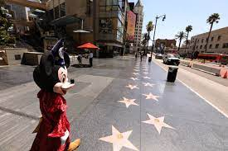

Introduction
Hollywood is worth over $42 billion as of 2019 alone.
13,500+ actors, $150 billion/year profit now.
There is still a large risk.
Hollywood relying solely on marketing to improve movie profits; it does not know which movies will succeed in advance.
It is very possible to predict the next blockbuster hit in advance.
Eliminates risk and increases profits.

Slide 3

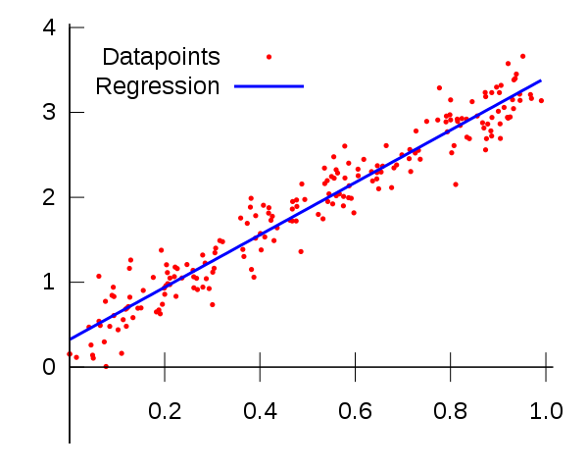
Our solution
How do we do this? We will use a machine learning model!
It finds relationships between movies’ IMDb scores and their information (actors, count, etc) to predict future scores.
Notes:
Left: The two types of machine learning illustrated. We will use the first type, regression.
Right: How regression draws relationships between two variables (linear here).

Slide 4
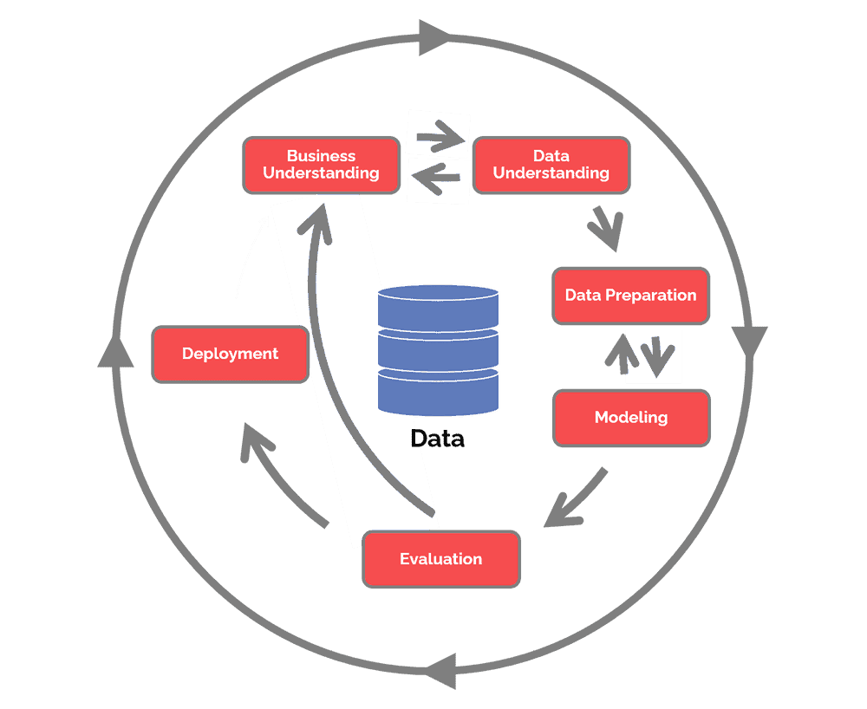
Analysis
How did we build the machine learning model?
1. Data preparation
2. Exploratory data analysis (EDA)
3. Model building and “grading” using RMSE.
What is RMSE?
Root Mean Squared Error (the closer it is to 0, the more accurate the model is).

Slide 5
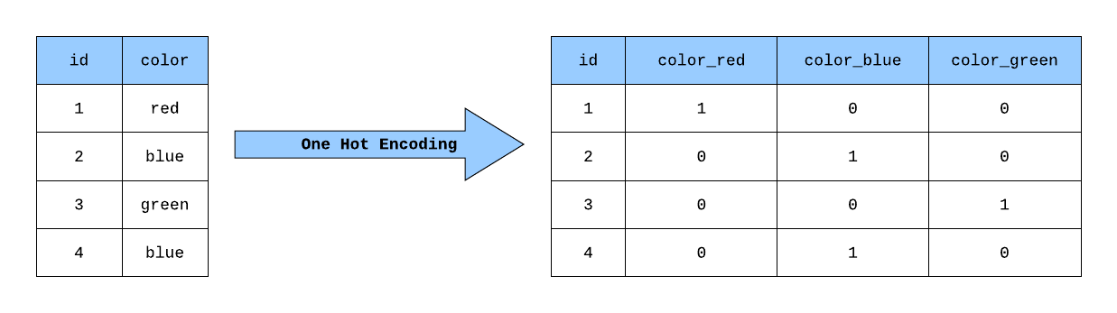
Part 1: Data Preparation
Making the data “clean” for building the model
Filling of N/A values with nmerical means
Removal of special characters and whitespaces
Removal of duplicate rows
One hot encoding- separate columns for each genre (see below illustration)

Slide 6
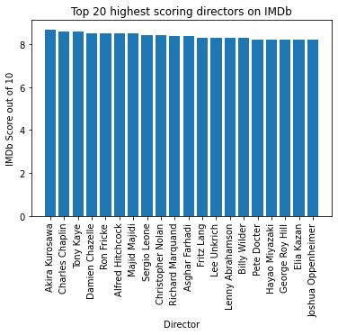
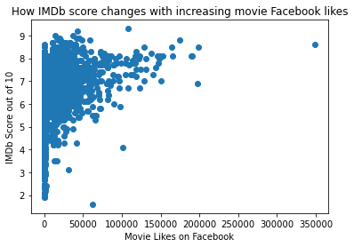
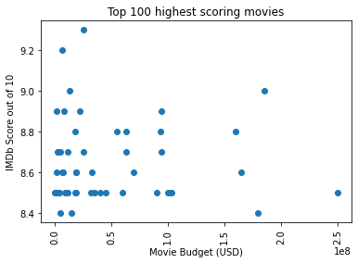
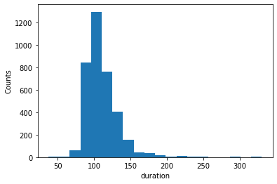
Part 2: EDA
Visualizing correlations with some plots
IMDb scores vs. Movie Budget
IMDb scores vs. Facebook Likes
Highest scoring directors barchart
More plots are included in the code

Slide 7
Part 3: Model Building
Modeled four variations of ridge regression with data split into training and testing sets.
Used RMSE to evaluate each model
Model | One-hot encoded features? | 10-fold cross-validation? | Train_test_split used? | RMSE
1 | NO | YES | NO | 0.69
2 | NO | NO | YES | 0.82
3 | YES | YES | NO | 0.87
4 | YES | NO | YES | 0.93

Slide 8
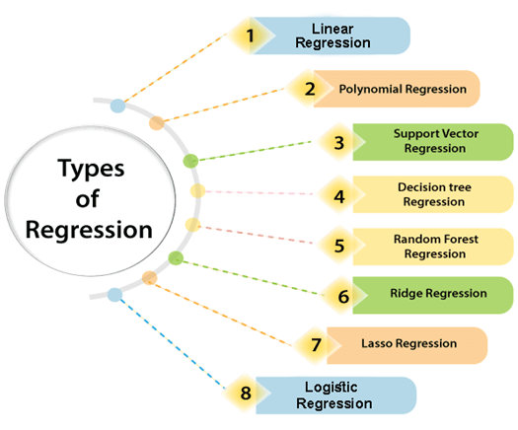
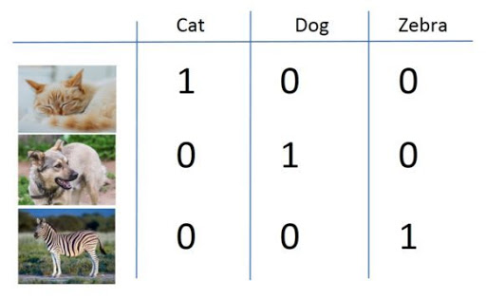
Challenges Encountered
We initially had difficulty finding the best regression model before settling on Ridge Regression.
Furthermore, we had issues including genre information that included multiple genres at once. We solved it through one-hot encoding.

Slide 9
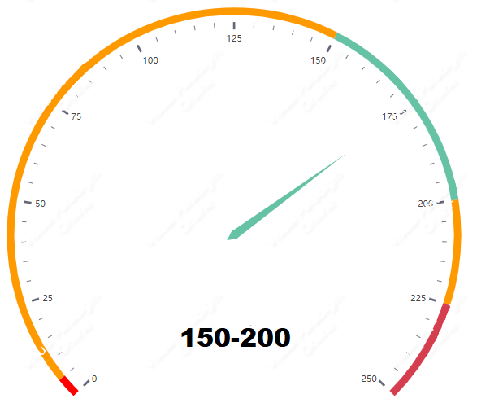

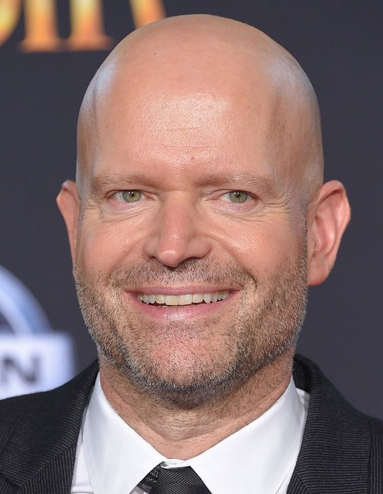







Results Summary
We found that these movies will score highest:

Slide 10


Future Work Required
The analysis conducted was not without limits. We could do more if we had:
Actor Budgets Movie Reviews

Slide 11


Acknowledgements
We would like to thank the following people for their continued enthusiasm and support during this MSDS program:

